Slide 1
Nearest EV charging station detection system using Dijkstra’s algorithm
Rajat Budhathoki | 20820/075
Bipin Chaudhary | 20800/075
Abhinna Ojha | 20788/075

Slide 2
Introduction
The big problem of EVs have been the range per charge.
There are limited EV charging stations and it can be very difficult for people to find the nearest charging station.
System aims to provide users a web-based platform that can detect the nearest charging station on their location and provide the shortest route to the available charging station

Slide 3
Objectives
To create a web based system that allows searching of nearest available EV charging station in a specified radius
To use Dijkstra’s algorithm to find the shortest route to the nearest available EV charging station

Slide 4
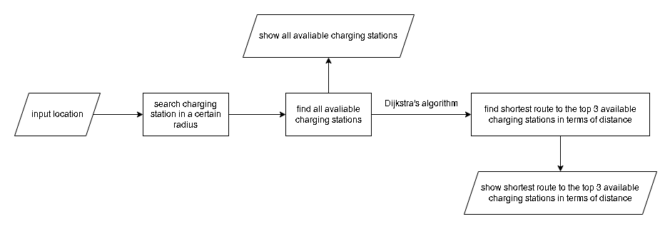
System flow diagram

Slide 5
Research papers and project reports reviewed
Dijkstra’s algorithm
Merin Puthuparampil
University of Malaya, Malaysia, 2012
Finding shortest path for road network using Dijkstra’s algorithm
Md. Almash Alam and Md. Omar Faruq
Published by Centre for Research on Islamic Banking & Finance and Business, Bangladesh, July-September, 2019
Analysis of Dijkstra’s Algorithm and A* Algorithm in Shortest Path Problem
Dian Rachmawati and Lysander Gustin
Universitas Sumatera Utara, Sumatra, 2020

Slide 6
Research papers and project reports reviewed
Project report finding shortest path using Dijkstra’s algorithm
Adrian Pradipta Winata
Soegijapranata Catholic University, Indonesia 2017
Route Suggestion System using Dijkstra’s algorithm
Nurul Atiqah Bt Ahmad Sabri
Universiti Sultan Zainal Abidin, Terengganu, Malaysia, 2017
Shortest path finder implementation of Dijkstra’s algorithm
Jeet Karia and Rahul Chocha
Ahmedabad University, India, January 2020

Slide 7
GitHub projects
kaldul/gps-nav: "GPS" Navigation Project
GPS nav, GPS navigation project
abdullahsumbal/McGillTour: McGill University Map for Directions
McGill Tour, find the shortest path between two building on McGill University Campus
ArghaKamalSamanta/Solving-a-randomly-generated-maze: solving a randomly generated maze through different path-finding algorithms
Path finding on a randomly generated maze
SmartEVSE/smartevse: Smart EVSE Electric Vehicle Charging Station
Smart EVSE Smart EVSE Electric Vehicle Charging Station

Slide 8
Similar websites
PlugShare - EV Charging Station Map - Find a place to charge your car!
Find an EV Charging Station Near You | EV Fast Charging Stations Map
Charging Stations in Nepal | Meromotor
Find Your Nearest EV Charging Station In Nepal - Nepal Drives

Slide 9
Other titles considered
Restaurant management system
Museum management system
Commercial job scheduling system
Automobile database manager
Fuel filling manager
EV charging detection system

Slide 10
Thank You

